Slide 1
Applied Statistics, Probability theory and mathematical statistics
István Fazekas, Attila Barta, Sándor Pecsora
Chebyshev's inequality, law of large numbers
”This work was supported by the construction EFOP-3.4.3-16-2016-00021. The project was supported by the European Union, co-financed by the European Social Fund.”

Slide 2
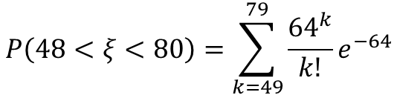

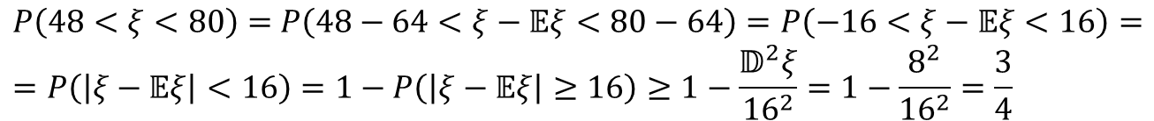
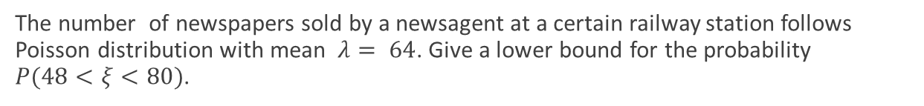



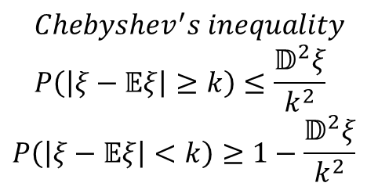
Exercise 15.1 (M1)
The number of newspapers sold by a newsagent at a certain railway station follows Poisson distribution with mean $λ= 64$. Give a lower bound for the probability $P(48<ξ<80)$.
$$ξ−number of sold newspapers$$
$$Chebyshev^{′}s inequality \\ P\left(\left|ξ−𝔼ξ\right|≥k\right)≤\frac{𝔻^{2}ξ}{k^{2}}$$
$$P\left(\left|ξ−𝔼ξ\right|<k\right)≥1−\frac{𝔻^{2}ξ}{k^{2}}$$
$$λ=64$$
$$ξ\sim Poisson\left(64\right)$$
$$𝔼ξ=λ=64=𝔻^{2}ξ$$
$$P\left(48<ξ<80\right)=\sum_{k=49}^{79}{\frac{{64}^{k}}{k!}}e^{−64}$$
$P\left(48<ξ<80\right)=$ $P\left(48−64<ξ−𝔼ξ<80−64\right)=P\left(−16<ξ−𝔼ξ<16\right)=$ $$=P\left(\left|ξ−𝔼ξ\right|<16\right)=1−P\left(\left|ξ−𝔼ξ\right|≥16\right)≥1−\frac{𝔻^{2}ξ}{{16}^{2}}=1−\frac{8^{2}}{{16}^{2}}=\frac{3}{4}$$

Slide 3
Exercise 15.1 (M1)
n = 10^5;
lambda = 64;
xi = poissrnd(lambda,[1 n]);
freq = cumsum(xi>48 & xi<80);
prob = freq./(1:n);
axis([0 n 0 1])
hold on
plot(1:n,prob)
plot(1:n,3/4.*ones(1,n),'r')
sum = 0;
for i = 49:79
sum = sum + (64^i/factorial(i))*exp(-64);
end
plot(1:n,sum.*ones(1,n),'g')

Slide 4
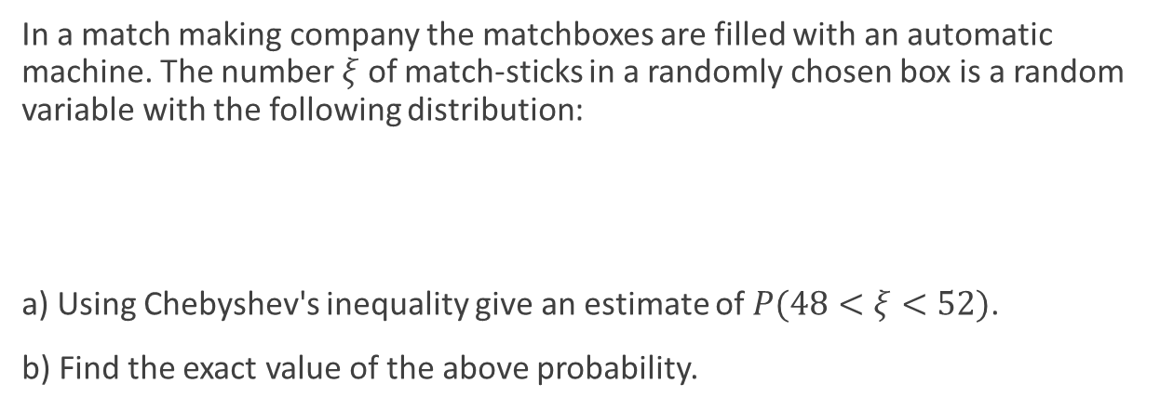

Exercise 15.4 (M2)
In a match making company the matchboxes are filled with an automatic machine. The number $ξ$ of match-sticks in a randomly chosen box is a random variable with the following distribution:
a) Using Chebyshev's inequality give an estimate of $P(48<ξ<52)$.
b) Find the exact value of the above probability.
number | 47 | 48 | 49 | 50 | 51 | 52 | 53
probability | 0.05 | 0.10 | 0.15 | 0.40 | 0.15 | 0.10 | 0.05
$$a) \\ 𝔼ξ=47×0.05+48×0.1+49×0.15+50×0.4+51×0.15+52×0.1+53×0.05=50$$
$$𝔻^{2}ξ=𝔼{\left(ξ−𝔼ξ\right)}^{2}=9×0.05+4×0.1+1×0.15+0+1×0.15+4×0.1+9×0.05=2$$
$$P\left(48<ξ<52\right)=P\left(−2<ξ−𝔼ξ<2\right)=P\left(\left|ξ−𝔼ξ\right|<2\right)≥1−\frac{2}{2^{2}} ≥\frac{1}{2}$$
$$b) \\ P\left(48<ξ<52\right)=P\left(ξ=49\right)+P\left(ξ=50\right)+P\left(ξ=51\right)=0.7$$

Slide 5
Exercise 15.4 (M2)
n = 10^5;
probs = [.05 .1 .15 .4 .15 .1 .05];
x = datasample(47:53,n,'Weights',probs);
length(x(x>48 & x<52))/n

Slide 6

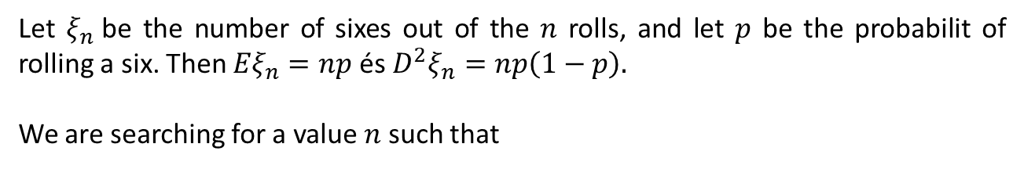
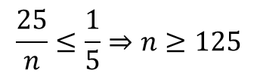
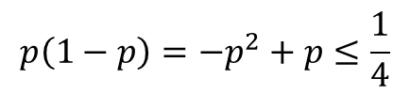
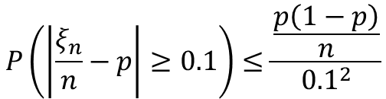
Exercise 15.7
How many times should a loaded die be rolled in order to obtain a relative frequency that approximates the probability of obtaining a six (that is not necessarily 1/6) with an error less than 0.1 with probability greater than or equal to 0.8?
Let $ξ_{n}$be the number of sixes out of the $n$ rolls, and let $p$ be the probabilit of rolling a six. Then ${Eξ}_{n}=np$ és ${D^{2}ξ}_{n}=np\left(1−p\right).$
We are searching for a value $n$ such that
$P\left(\left|\frac{ξ_{n}}{n}−p\right|<0.1\right)≥0.8,$ so $P\left(\left|\frac{ξ_{n}}{n}−p\right|≥0.1\right)≤0.2$
$$p\left(1−p\right)=−p^{2}+p≤\frac{1}{4}$$
By Chebyshev's inequality,
$$P\left(\left|\frac{ξ_{n}}{n}−p\right|≥0.1\right)≤\frac{\frac{p\left(1−p\right)}{n}}{{0.1}^{2}}$$
$$≤\frac{1}{4n}×100=\frac{25}{n}$$
$$\frac{25}{n}≤\frac{1}{5}⇒n≥125$$

Slide 7
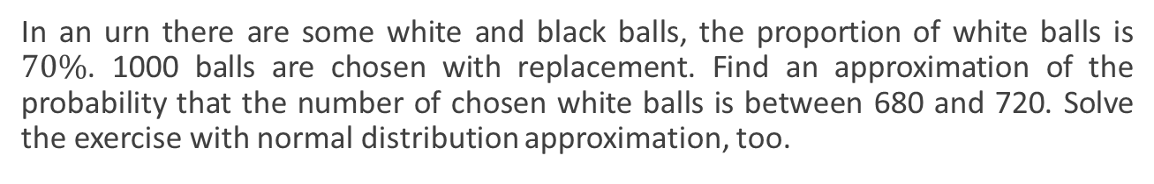
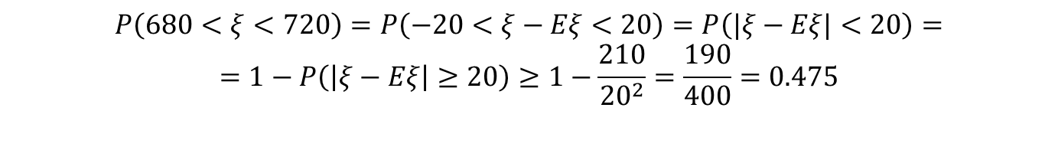
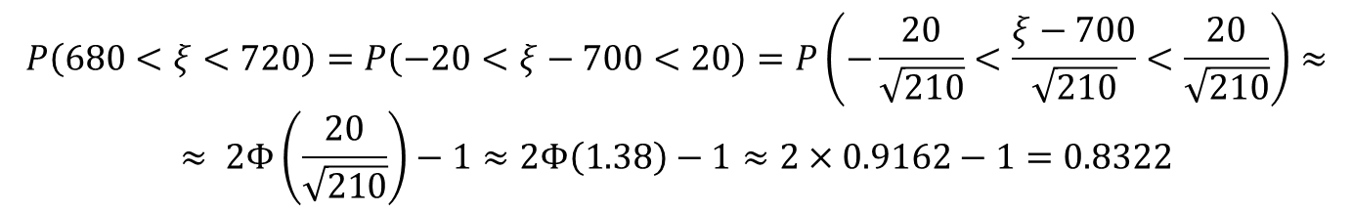

Exercise 15.10 (M3)
In an urn there are some white and black balls, the proportion of white balls is $70\%$. 1000 balls are chosen with replacement. Find an approximation of the probability that the number of chosen white balls is between 680 and 720. Solve the exercise with normal distribution approximation, too.
$$ξ −number of white balls from 1000 samples$$
$$ξ \sim Bin(1000,0.7)$$
I.
$$P\left(680<ξ<720\right)=P\left(−20<ξ−Eξ<20\right)=P\left(|ξ−Eξ|<20\right)= \\ =1−P\left(\left|ξ−Eξ\right|≥20\right)≥1−\frac{210}{{20}^{2}}=\frac{190}{400}=0.475$$
II.
$$P\left(680<ξ<720\right)=P\left(−20<ξ−700<20\right)=P\left(−\frac{20}{\sqrt{210}}<\frac{ξ−700}{\sqrt{210}}<\frac{20}{\sqrt{210}}\right)≈ \\ ≈ 2Φ\left(\frac{20}{\sqrt{210}}\right)−1≈2Φ\left(1.38\right)−1≈2×0.9162−1=0.8322$$

Slide 8
Exercise 15.10 (M3)
n =10^4;
c = 0;
for i=1:n
balls = rand(1,1000);
w_n = length(balls(balls<0.7));
if w_n>680 & w_n<720
c = c+1;
end
end
c/n
2*normcdf(1.38)-1

Slide 9
Literature
Ágnes Baran: Mathematics for engineers 1. (Laboratory slides)
Sándor Baran: Probability theory and statistics
Fazekas István: Valószínűségszámítás, Debreceni Egyetemi Kiadó, 2009
Fazekas István: Bevezetés a matematikai statisztikába, Debreceni Egyetemi Kiadó, 2009
Matlab examples: https://www.mathworks.com/help/examples.html

